Slide 1


Lesson 3: Customer & Solution
Customer Vs Consumer
Different Types of Start-up
Segmentation and Targeting
Niche Marketing
Value Proposition Design
Outcome Driven Innovation
Presentation on Value Proposition Canvas

Slide 2
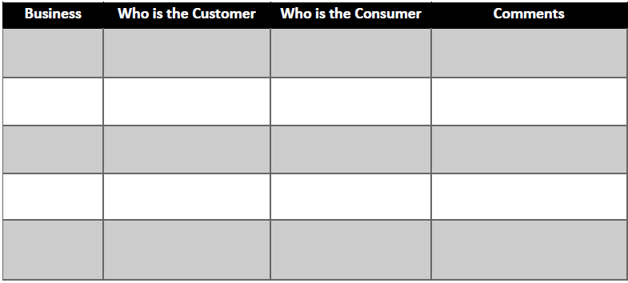

Slide 3
Different Types of Start-ups
    Existing Markets
    New Markets
    Re-segmented Market
    Clone Market

Slide 4
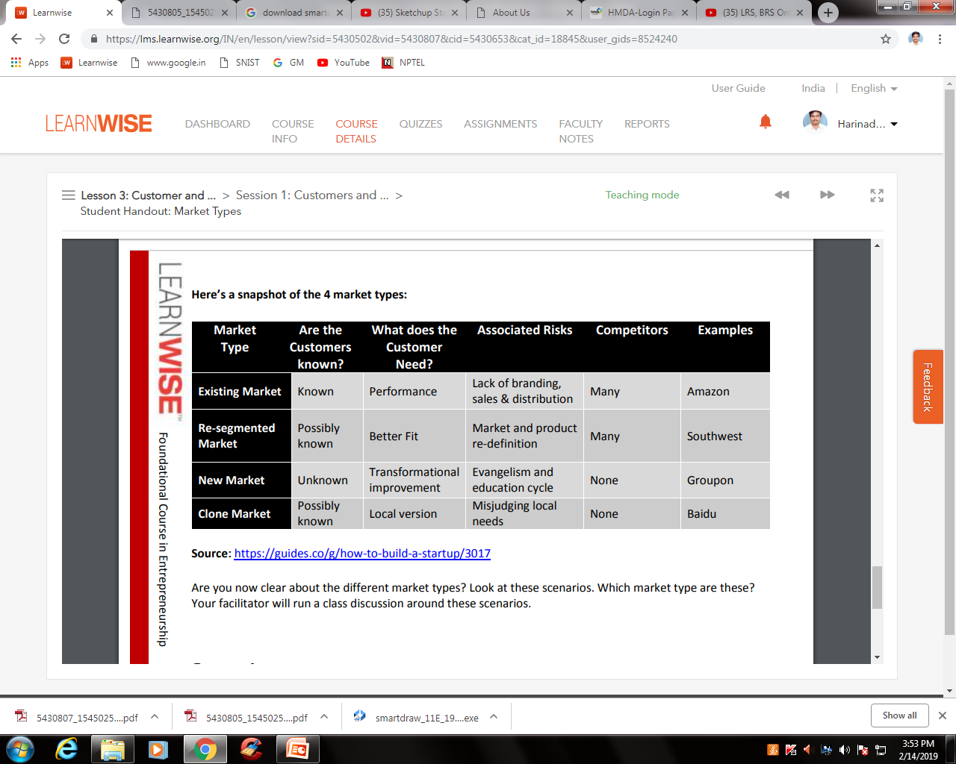
Elements of Different Types of Start-Ups

Slide 5
Market Segmentation
Market segmentation is the activity of dividing a broad consumer or business market, normally consisting of existing and potential customers, into sub-groups of consumers based on some type of shared characteristics.
  Geographic Segmentation
  Demographic Segmentation
  Psychographic Segmentation
  Behavioristic Segmentation

Slide 6
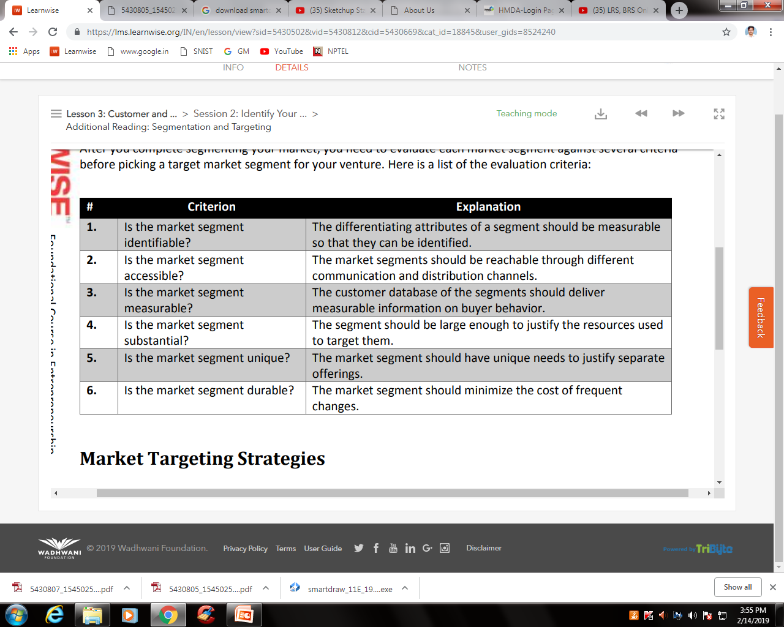
Evaluation Criterions of Segment

Slide 7
Market Targeting
A target market is a group of consumers or organizations most likely to buy a company's products or services. Because those buyers are likely to want or need a company's offerings, it makes the most sense for the company to focus its marketing efforts on reaching them.

Slide 8
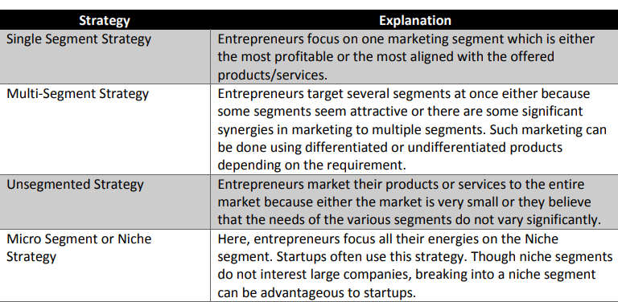
Strategies of Targeting

Slide 9
Niche Marketing
A niche market is the subset of the market on which a specific product is focused. The market niche defines the product features aimed at satisfying specific market needs, as well as the price range, production quality and the demographics that it is intended to target. It is also a small market segment.

Slide 10
Value Proposition Canvas
The Value Proposition Canvas. Create the value your customers want. A simple way to understand your customers needs, and design products and services they want. It works in conjunction with the Business Model Canvas and other strategic management and execution tools and processes.

Slide 11
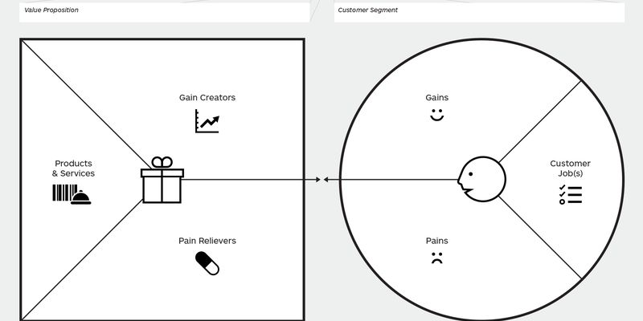
Value Proposition Canvas

Slide 12
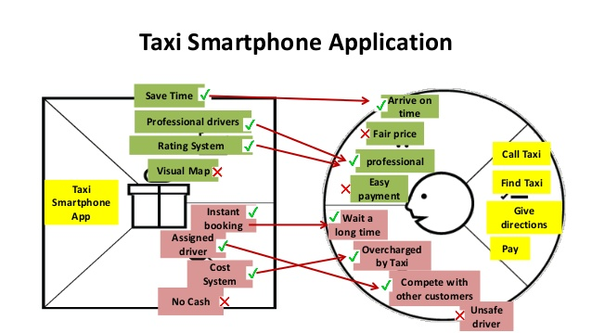
Example of Value Proposition Canvas

Slide 13
THANK YOU

